Slide 1
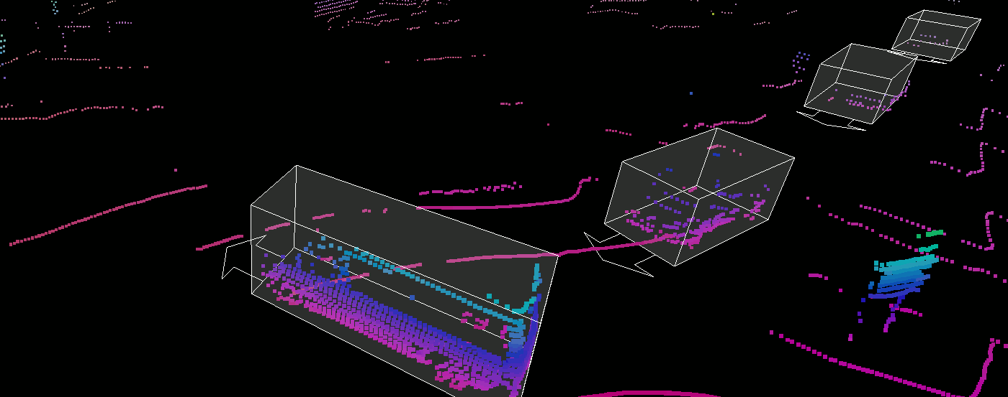
LIDAR's Intelligent Crowd Counting
LI YIAN - A0101907N
ANIRBAN KAR CHAUDHRI - A0108517H
ANKEIT TAKSH - A0213496B
PRASHANT CHAUDHARY - A0213485E
Notes:
Good afternoon this is Ian from team 19, our capstone project is to use lidar point cloud data to do crowd counting

Slide 2
Overview
Sponsor Company Background
Project Background
Project Objective & Scope
Project Deliverable
Stage 1: 3D Data Augmentation
Dataset Exploring
Data Augmentation Key Consideration
Pipeline Design & Primary result
Stage 2: 3D Detection Model
Literature Review
Plan and Schedule
Agenda

Slide 3
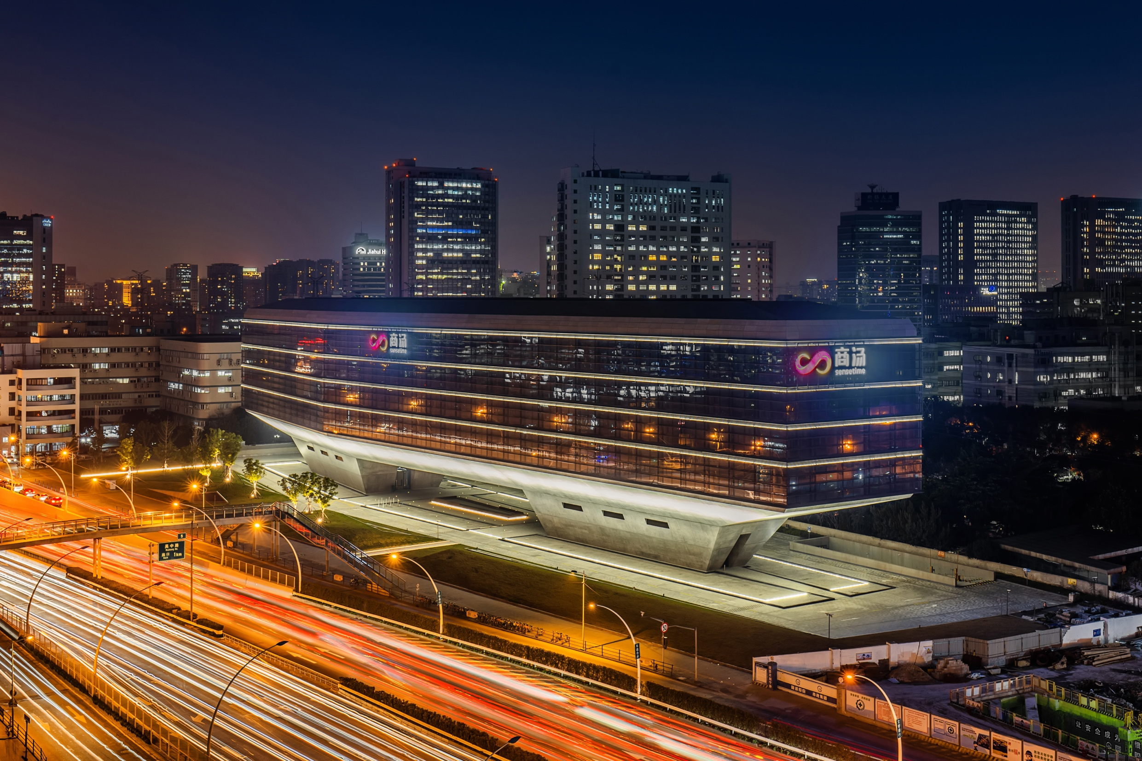












Sensetime’s Investors
Valued at over $12 billion USD
Notes:
Our sponsor company is sensetime
AI unicorn specialized in CV field
Start from a multimedia lab in Chinese University of Hong Kong (CUHK) and grow to a multinational organization today.
Well received by international investor
Valued at over 12 billion USD makes it the most valuable AI unicorn in the world

Slide 4
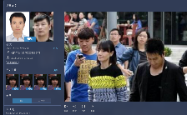
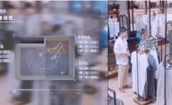


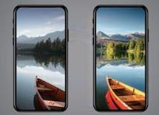
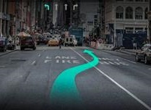
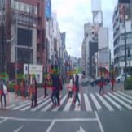


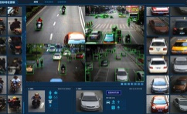

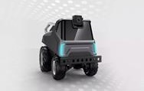
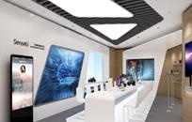

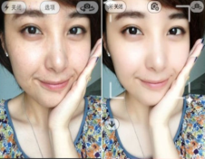
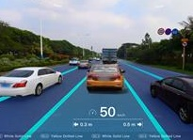
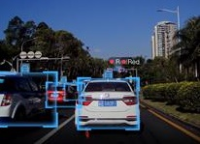
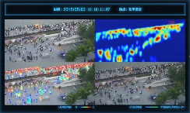
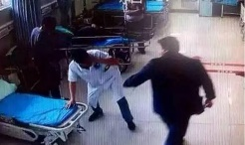

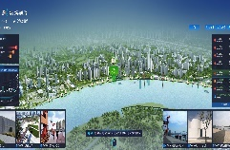
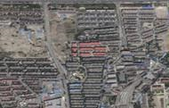


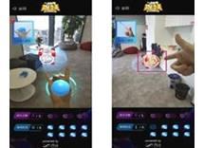
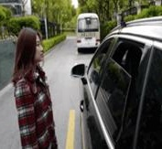

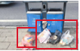
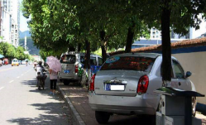



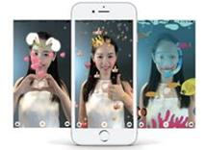
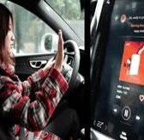
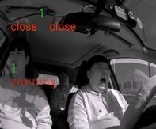
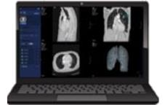
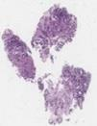
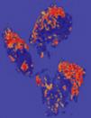
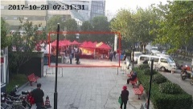
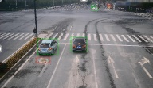
SenseTime – World Leading AI Innovation Platform
Smart City
Business Intelligence
Mobile Solution
Autonomous Driving
AI Education Package
Smart Surveillance
Smart City Management System
Retail Analytics Solutions
Intelligent Hotel Check in System
Face Unlock
Photo Processing
Guide Line Prediction
Human Face Prediction
AI Textbook
AI Experiment Platform
Smart Traffic Management
Fire Detection
Smart Airport Solution
Smart Metro Solution
AI RobotCar
AI Lab
Image Super Resolution
3D Face Beautification
Lane Detection
Front Vehicle Detection
Smart Crowd Management
Abnormal Behavior Detection
Smart Office Management System
Smart Tourism Area Management
Remote Sensing
AR Platform
Intelligence Cabin Sensing
Road Network Extraction
Cloud and Snow Detection
AR Live Streaming
AR Game
Face Unlock
Gaze Tracking
Garbage Detection
Illegal Parking Detection
Smart Entertainment Solution
Smart Campus Solution
AI-Enabled Diagnosis, Treatment and Rehabilitation
Illegal Occupation Detection
Abnormal Objects Detection on Road
Smart Amusement Park Solution
Real Estate Sales Management
AR Classroom
AR Effect
Gesture Tracking
Drowsiness detection
Lung AI Application
Pathology Application
Notes:
Apply computer vision and VA in different scenario
Smart city
surveillance
crowd
BI
airport
tourism
office building
from rich projects with different industry R&D fount that dense scenario is becoming increasingly important

Slide 5
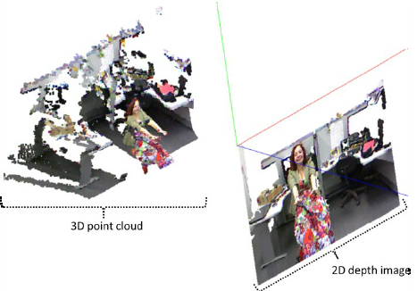
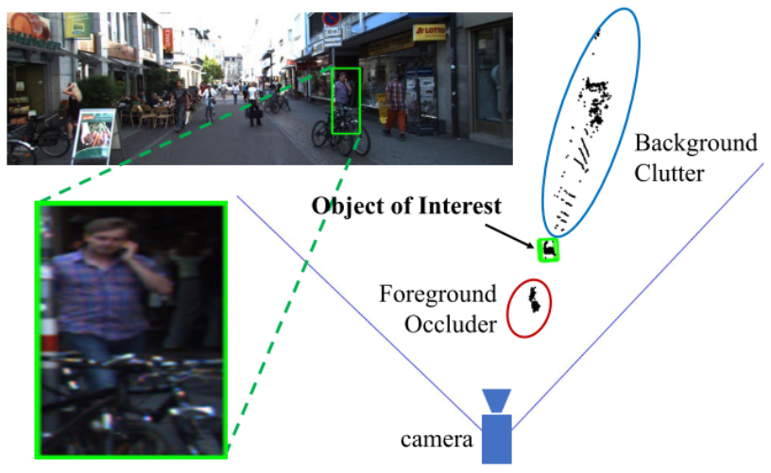
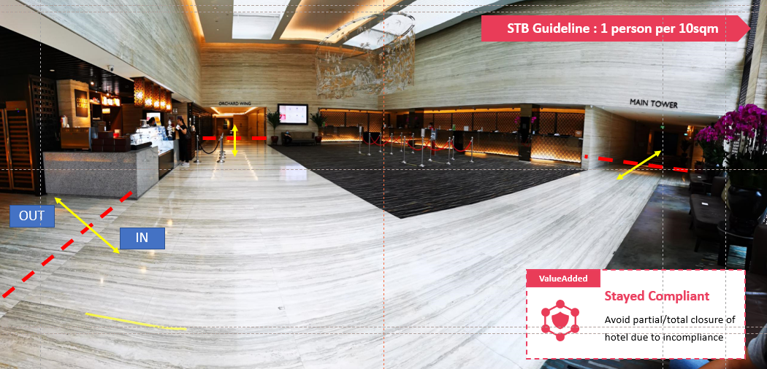
Project Background
Business background:
Knowing No of people in a venue under dense scenario showing increasing demand
How LiDAR Can Help?
Rich 3D Depth Info
Business Application:
Smart City - predict and prevent overcrowd and trample in popular attraction (e.g. new year countdown)
Retail Industry - Identify Hot zone to optimize store layout and maximize store revenue
Tourism Industry - Compliance with STB people density requirement (1 person/10 sqm)
Handle Occlusion & Easier Fusion
Technical Challenge: Loss of Depth, Occlusion ,change of lighting, pose a challenge to traditional RGB Camera based solution
Lighting Independent
Notes:
Businees Task is to Knowing No of people in a venue under dense scenario showing increasing demand
Direct 3D info xyz
Occlusion ,easier to do multiple sensor fusion
LiDAR is not sensitive to the variations of lighting conditions and can work under day and night, even with glare and shadows.

Slide 6
Project Objective & Scope
Objective: To develop a Crowd Pedestrian Detection Deep learning model using LiDAR sensor data only
Stage 1 : Augment Dataset Generation
Augment dataset from KITTI/ Waymo Open Dataset for Dense scenario
Pedestrian to be densely placed on terrain or Street without collision with other points
Dataset will be used for Capstone project and future R&D projects
Performance Index:
7000+ training point cloud frames
Stage 2 : Develop a Crowd Pedestrian Detection model
Run on point cloud data independently
Process point cloud frames and detected Pedestrian under dense scenario
Support Business application such as cross-line counting and regional people counting
Performance Index:
Better than benchmark pointRCNN under dense scenario

Slide 7
Project Deliverable
Stage 1 : Augment Dataset Generation
Dataset with 7000+ training point cloud frames with Pedestrian randomly and densely on the street
Value to Sponsor:
To pretrain detection model using the dataset
To pretrain multi lidar fusion model using the dataset
To future Improve the dataset and potentially release
Stage 2 : Develop a Crowd Pedestrian Detection model
A 3D detection model under dense scenario
Value to Sponsor:
To future generate SDK for POC & Demo
Act as Baseline model for multi LiDAR fusion Research

Slide 8
Overview
Sponsor Company Background
Project Background
Project Objective & Scope
Project Deliverable
Stage 1: 3D Data Augmentation
Dataset Exploring
Data Augmentation Key Consideration
Pipeline Design & Primary result
Stage 2: 3D Detection Model
Literature Review
Plan and Schedule
Agenda

Slide 9
Data Exploring - 3D LiDAR Datasets
Datasets for 3D Object Detection and Tracking
Name & Reference | Year | #Scenes | #Classes | #Annotated Frames | #3D Boxes | Scene Type | Sensors
KITTI | 2012 | 22 | 8 | 15K | 200K | Urban (Driving) | RGB & LIDAR
SUN RGB-D | 2015 | 47 | 37 | 5K | 65K | Indoor | RGB-D
ScanNetV2 | 2018 | 1.5K | 18 | - | - | Indoor | RGB & Mesh
H3D | 2019 | 160 | 8 | 27K | 1.1M | Urban (Driving) | RGB & LIDAR
Argoverse | 2019 | 113 | 15 | 44K | 993K | Urban (Driving) | RGB & LIDAR
Lyft L5 | 2019 | 366 | 9 | 46K | 1.3M | Urban (Driving) | RGB & LIDAR
A*3D | 2019 | - | 7 | 39K | 230K | Urban (Driving) | RGB & LIDAR
Semantic KITTI | 2017 | 11 | 28 | 15K | Segmentation | Urban (Driving) | RGB & LIDAR
Waymo Open | 2020 | 1K | 4 | 200K | 12M | Urban (Driving) | RGB & LIDAR
nuScenes | 2020 | 1K | 23 | 40K | 1.4M | Urban (Driving) | RGB & LIDAR
Notes:
Kitti is the pioneer in 2012 and very well received by the industry
Recently hot many labs are doing this, Waymo champion by google
But formatting are quite different from different source. So we use the pioneer kiti and semantic kitti. Semantic kitti provide a rich info on semantic segmentation, so you know every point in a frame , what is it.

Slide 10
Data Exploring - Pedestrians Datasets
Datasets | #Cams | Scene | Annotation unit | #Samples | #Resolution | #Binary Attributes | View Point | Occlusion | Part location
VIPeR [8] | 2 | outdoor | PID | 1264 | 48 x 128 | 21 | yes | no | no
PRID r9J | 2 | outdoor | PID | 400 | 64 x 128 | 21 | no | no | no
GRID [l 7] | 8 | outdoor | PID | 500 | from 29 x 67 to 169 x 365 | x | 67 | no | no
APiS [34) | - | outdoor | PI | 3661 | 48 x 128 | x | 365 | no | no
PETA (2) | - | mixture | PID | 19,000 | 117 x 39 to 169 x 365 | 61 | no | no | no
RAP | 26 | indoor | PI | 41585 | from 36 x 92 to 344 x 554 | 69 | yes | yes | yes
Lack of 3D Pedestrians Dataset
Notes:
All image based, lack of a pointcloud based dataset for pedestrian

Slide 11
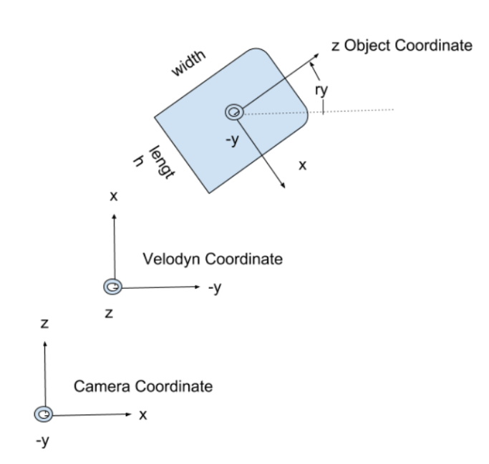
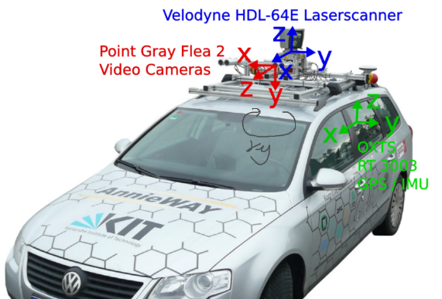
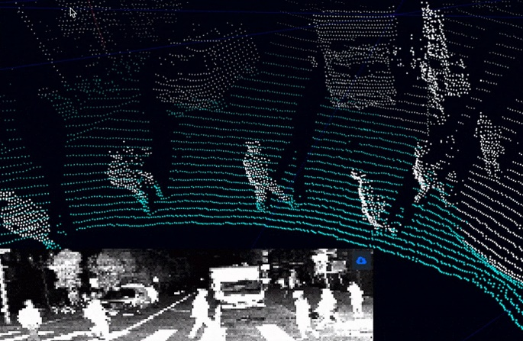
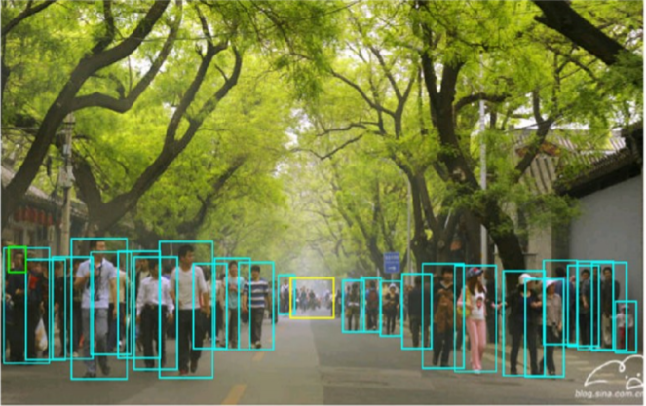
Data augmentation Key Consideration
‘Data augmentation plays an important role in boosting the performance of 3D models. 3D labelling is much more time-consuming compared to 2D labelling, which leads to most of the 3D datasets having a limited amount of training samples.’[1]
Pedestrian Placement
Object Angle
ry & Alpha
Camera-Velodyn Coordinate System
How to Make Augmented data more real?
Collision[2]
Occlusion
[1]Jaeseok Choi, Yeji Song and Nojun Kwak.Part-Aware Data Augmentation for 3D Object Detection in Point Cloud
[2] Yan Yan, Yuxing Mao, and Bo Li. SECOND: Sparsely embedded convolutional detection. Sensors, 2018
Notes:
[1]Jaeseok Choi, Yeji Song and Nojun Kwak.Part-Aware Data Augmentation for 3D Object Detection in Point Cloud
Consideration:
Placement of Pedestrian
Camera & Velodyn Coordinate
Angle Ry & Alpha
Collision
Occlusion

Slide 12
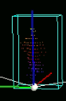
Dataset Argumentation – Pipeline Design & Primary Result
1. Object Sample Database Generation pipeline
Done
Kitti Object Label file
Pedestrian 3D Bounding box and size
(x,y,z,h,w,l) in Camera Coordinate
Object Angel
ry & Alpha
Kitti Object Calibration file
Transfer bounding box to Velodyn Coordinate using T_vc
Camera-Velodyn Coordinate System
(x,y,z,h,w,l) Velodyn Coordinate
Dataset of 4487 Pedestrian Sample
Transition and rotation the entire point cloud scene to Pedestrian bottom central
Kitti Object pointcloud data file
Save label into text file with xyz=0
Crop and save point cloud data within bounding box and save to bin file
Point cloud Pedestrian label
Point cloud Pedestrian Sample
(x y z against its bottom centre)
Notes:
[46] Yan Yan, Yuxing Mao, and Bo Li. SECOND: Sparsely embedded convolutional detection. Sensors, 2018

Slide 13
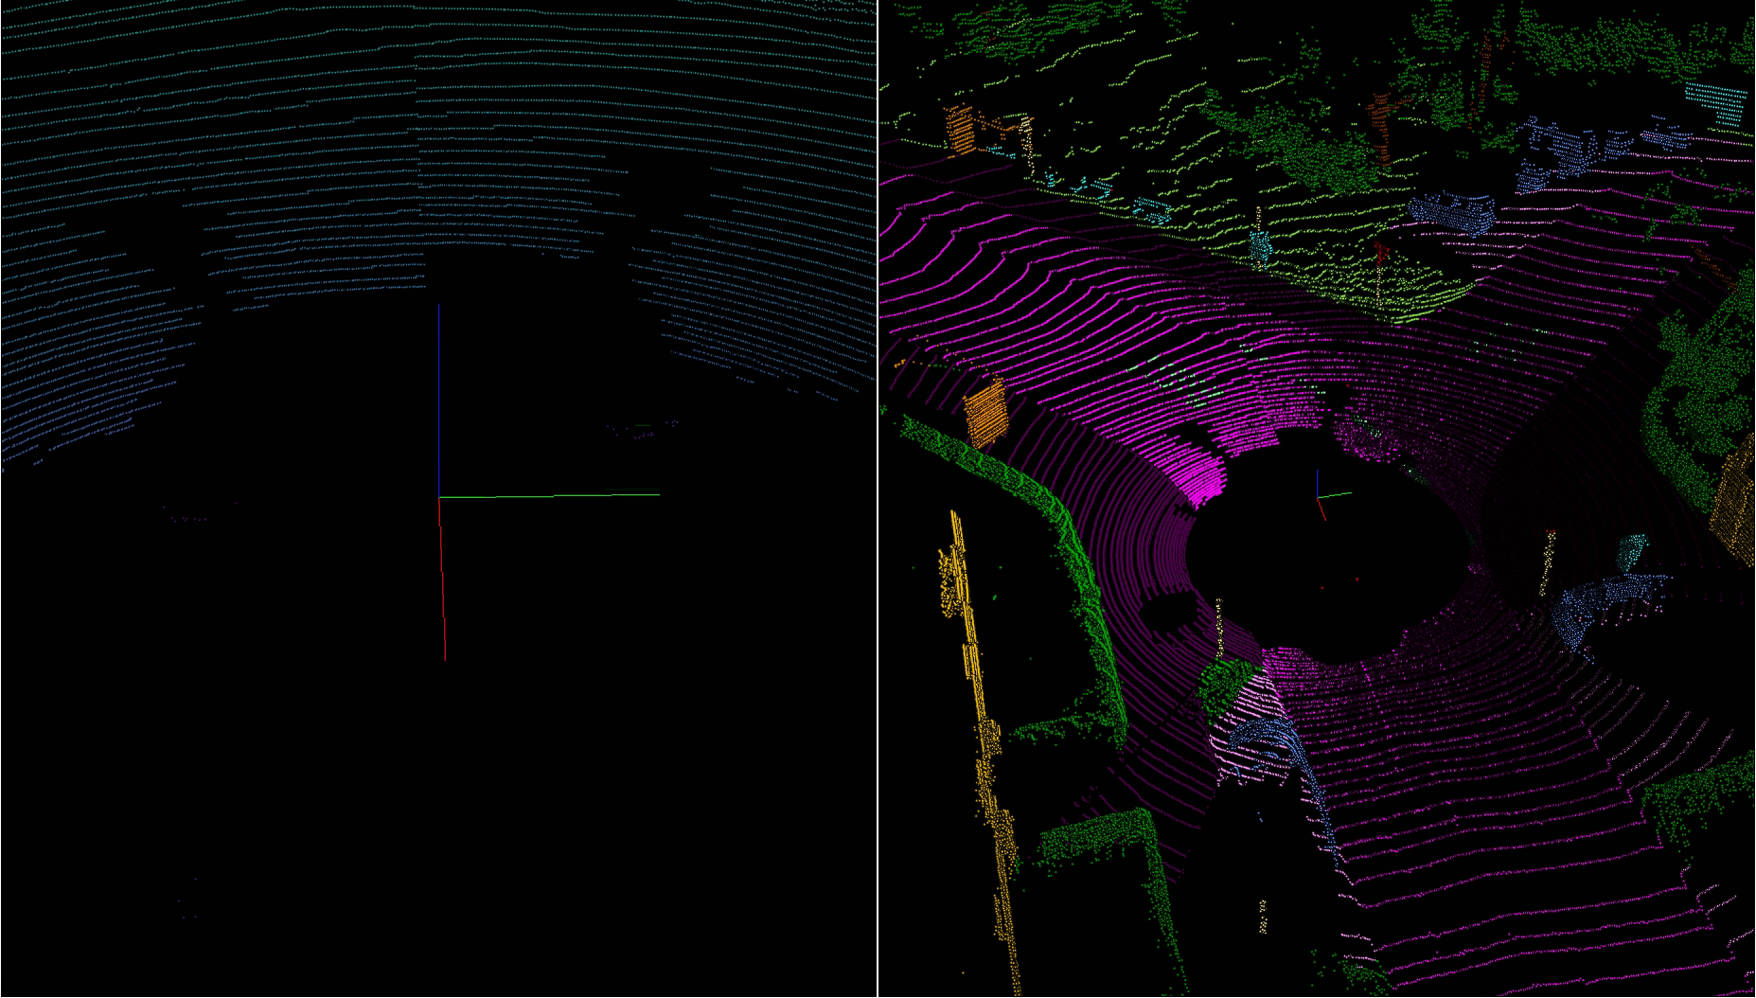
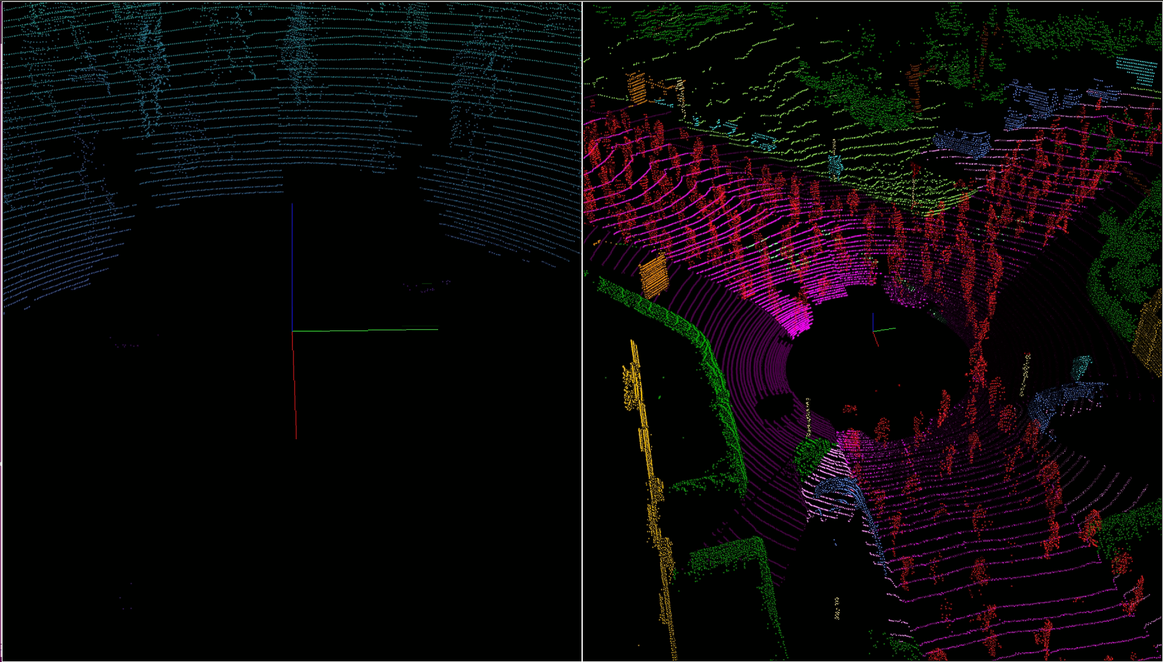
Dataset Argumentation – Pipeline Design & Primary Result
2a. Densely dispense Pedestrian to road on Scene
Done
Control Variable
Semitic kitti point cloud & label file
Short list points cloud location for road (label=40) as placement list
Bottom central (x,y,z), Velodyn Coordinate
Pedestrian Placement
Pedestrian Occlusion ratio
Point cloud Pedestrian Sample
Random select a road point as Pedestrian bottom centre & drop pedestrian sample
Pedestrian (x,y,z) Velodyn Coordinate
Camera-Velodyn Coordinate System
Pedestrian Transaction ratio
Collision
Before
After
Augmented scene object label
Transfer Pedestrian bounding box to camera coordinate and add to label file
Compute region occupied by Pedestrain
Remove points inside the region
Pedestrian (x,y,z) camera Coordinate
Remove points inside the region from placement list
Placement list empty?
No
Yes
Scene pointcloud
Pedestrian labels camera coordinate
Save point cloud and label file
Notes:
[46] Yan Yan, Yuxing Mao, and Bo Li. SECOND: Sparsely embedded convolutional detection. Sensors, 2018
Success doing this
very dense
On the road

Slide 14
Dataset Argumentation – Pipeline Design & Primary Result
2b. Densely dispense Pedestrian to road on Scene
Doing
Control Variable
Semitic kitti point cloud & label file
Short list points cloud location for road (label=40) as placement list
Bottom central (x,y,z), Velogyn Coordinate
Pedestrian Placement
Pedestrian Occlusion ratio
Categorize road list to 8 category according to angle and distance
Point cloud Pedestrian Sample
Camera-Velodyn Coordinate System
Pedestrian Transaction ratio
Random select a Pedestrian sample and drop into the 8 category according to alpha angle and original distance to origin
Collision
Object Density at Scene angle
Pedestrian (x,y,z)
Velodyn Coordinate
Object Angel
ry & Alpha
Augmented scene object label
Transfer Pedestrian bounding box to camera coordinate and add to label file
Compute region occupied by Pedestrian
x
Remove points inside the region
Pedestrian (x,y,z) camera Coordinate
8
5
Remove placement list inside the region
4
1
y
Placement list empty?
No
3
2
Yes
Scene pointcloud
Pedestrian labels camera coordinate
7
6
Save point cloud and label file
Notes:
[46] Yan Yan, Yuxing Mao, and Bo Li. SECOND: Sparsely embedded convolutional detection. Sensors, 2018

Slide 15
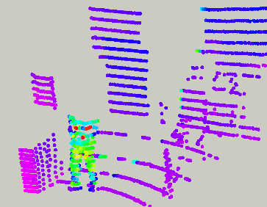
Dataset Argumentation – Pipeline Design & Primary Result
2c. Densely dispense Pedestrian to road on Scene
Occlusion Handling
Doing
Semitic kitti point cloud & label file
Short list points cloud location for road (label=40) as placement list
Bottom central (x,y,z), Velogyn Coordinate
Compute projection area from origin to nearest object
To-do
Categorize road list to 8 category according to angle and distance
Pedestrian Placement
Point cloud Pedestrian Sample
Remove points in the projection area
Camera-Velodyn Coordinate System
Random select a Pedestrian sample and drop into the 8 category according to alpha angle and original distance to origin
Pedestrian (x,y,z)
Velodyn Coordinate
Repeat the above two steps for all objects
Collision
Augmented scene object label
Transfer Pedestrian bounding box to camera coordinate and add to label file
Compute region occupied by Pedestrain
Object Angel
ry & Alpha
Drop Object and label if number of points below threshold
Remove points inside the region
Occlusion
Pedestrian (x,y,z) camera Coordinate
Remove placement list inside the region
Save file End
Placement list empty?
No
Yes
Notes:
[46] Yan Yan, Yuxing Mao, and Bo Li. SECOND: Sparsely embedded convolutional detection. Sensors, 2018

Slide 16
Overview
Sponsor Company Background
Project Background
Project Objective & Scope
Project Deliverable
Stage 1: 3D Data Augmentation
Dataset Exploring
Data Augmentation Key Consideration
Pipeline Design & Primary result
Stage 2: 3D Detection Model
Literature Review
Plan and Schedule
Agenda

Slide 17
Literature Review-Challenges on Point Cloud Processing
Unstructured
Sparse
Unordered

Slide 18
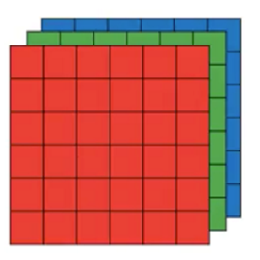
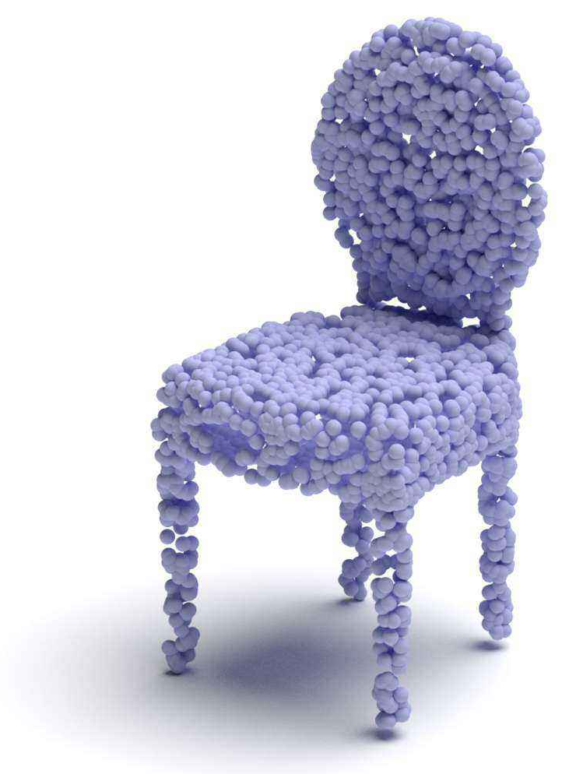
Literature Review-Challenges on Point Cloud Processing
Image
Unstructured
Point Cloud
Notes:
unstructured because they have no information about the sensor structure, etc. It's really just a set of unorganized points (at least explicitly).

Slide 19
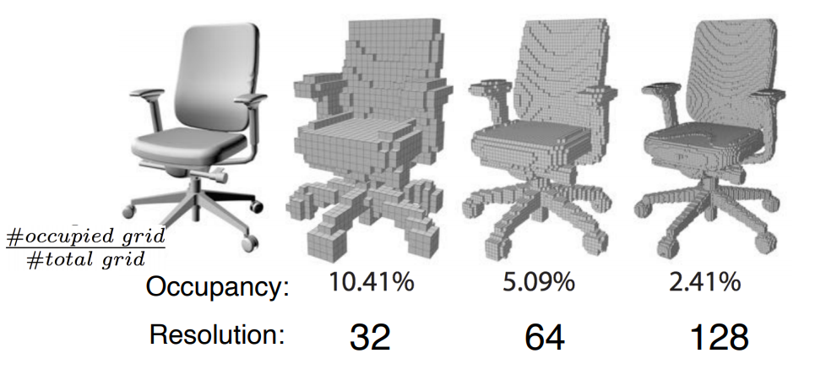
Literature Review-Challenges on Point Cloud Processing
Voxelization

Slide 20
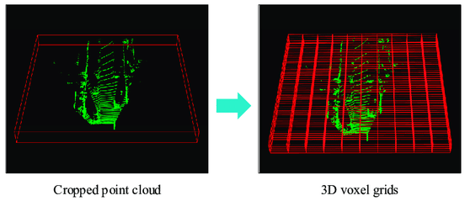
Literature Review-Challenges on Point Cloud Processing
Sparse

Slide 21
Literature Review-Challenges on Point Cloud Processing
x | y | z
0.76831 | 0.69173 | 0.12332
0.36281 | 0.23456 | 0.88273
0.12378 | 0.12373 | 0.34667
Unordered
…

Slide 22
Literature Review-Challenges on Point Cloud Processing
Available Approaches (3 subcategories)
Pixel-based: Projects the 3D point cloud into 2D, either Bird-Eye-View (BEV) or front view.
Voxel-based: Partition the 3D space into voxel grid and utilize neural networks to extract features
3D point-based: Directly takes the raw point cloud as input in the form, complicated statistics operations not needed
Our Approach
Directly processing LiDAR 3D point-based data using point net idea
Why Direct 3D point cloud data processing is preferred?
No information loss - unlike other 2 approaches namely Pixel based and Voxel based
Less Sparse and waste of computing power

Slide 23
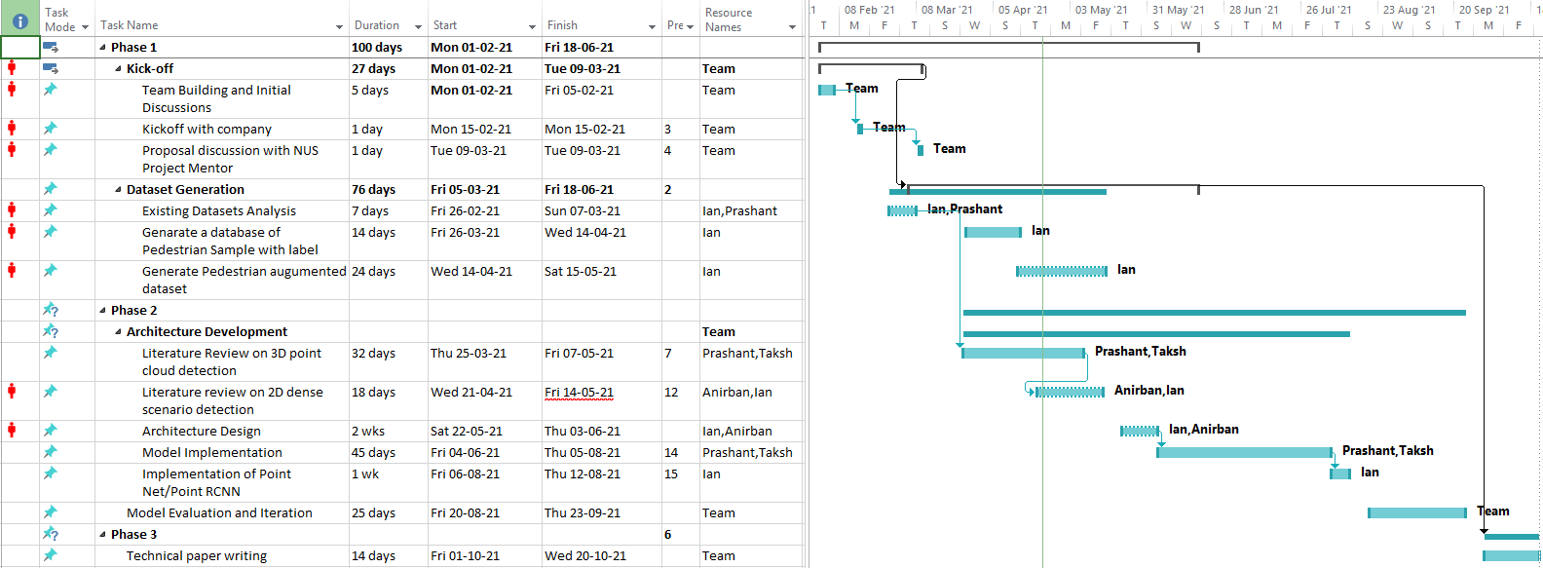
Project Plan & Schedule
Notes:
We have
Meeting with sponsor team, mentor to gather requirement and feedback progress and get advice
Stage 1 Dataset generation is 60%, target to finish by may
Stage 2 doing literature review, next step need to design and implement our own pipline and target to finish by Sep.

Slide 24
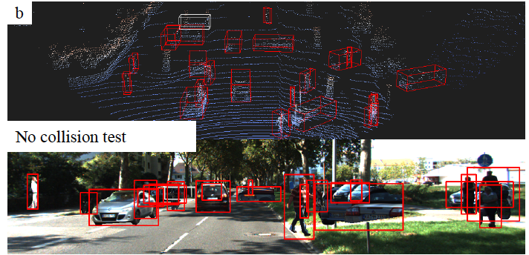
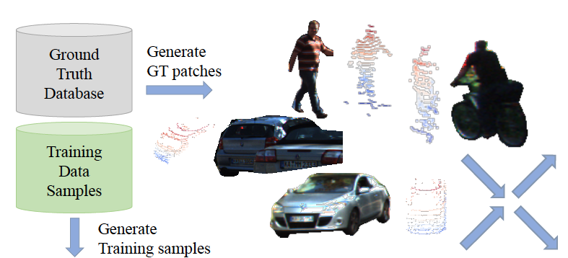
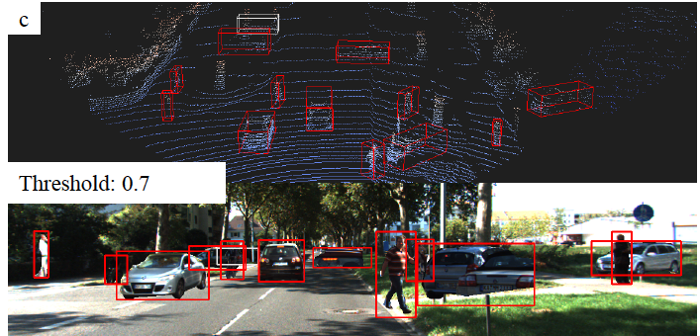
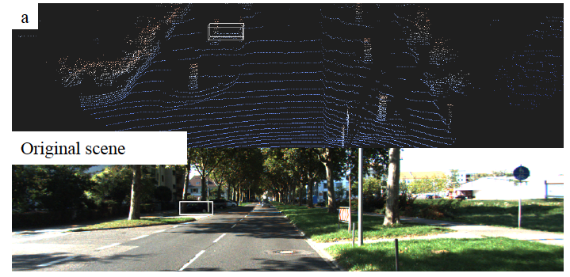
Multi-Modality Cut and Paste for 3D Object Detection

Slide 25
Multi Modality Augmentation
POINTS
Rotaion
Translation
Flip
Input Points
Point Feature
Fused Features
Projection
Forward Transformation
Image
Rsize and Flip
Input Image
POINTS
Image Features
Point FEatures

Slide 26
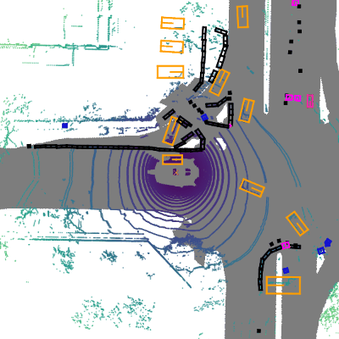
MMDetection3D is an open source object detection toolbox based on PyTorch, towards the next-generation platform for general 3D detection. It is a part of the OpenMMLab project developed by MMLab.

